Slide 1
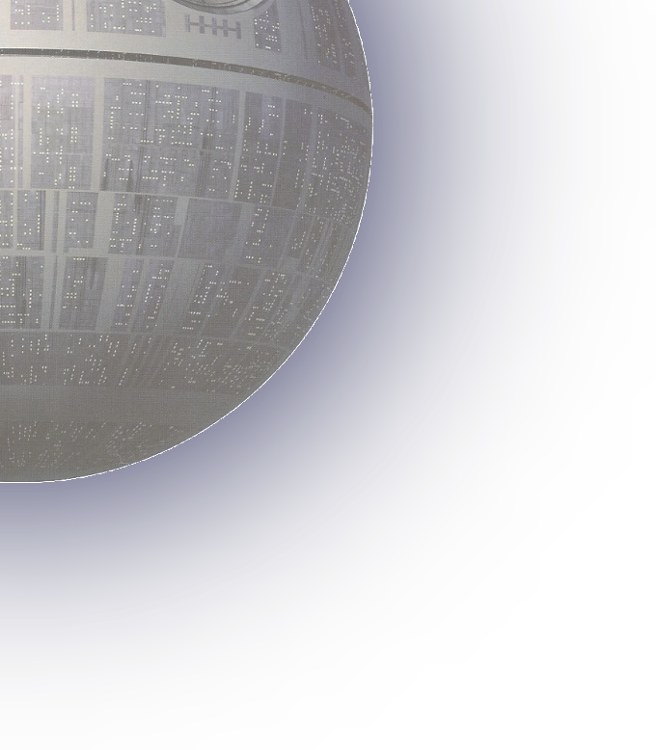












NITSHACKS 2024
\nits hacks 7.0
North-east India’s Most Premium Hackathon
Title Page
Problem Statement Title : On device semantic segmentation of WMS services with geospatial data export
Theme : Open Innovation Hackathon
Team Name : Achievers NR

Slide 2



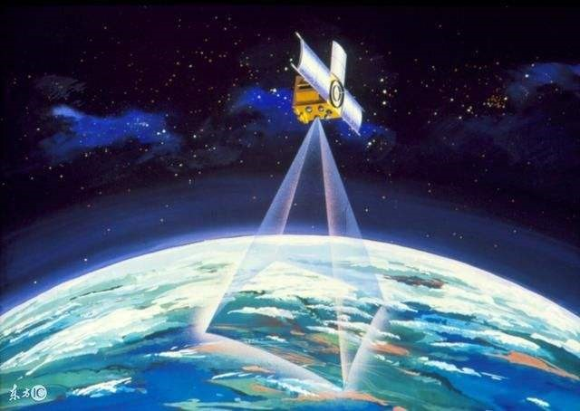
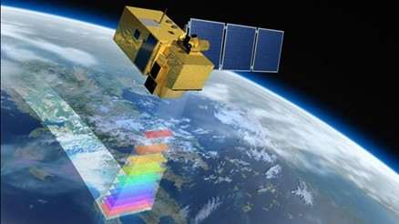
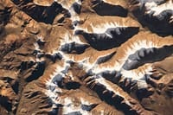
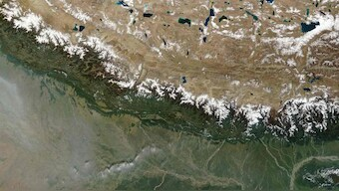
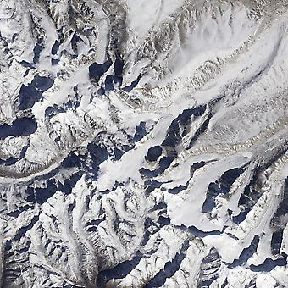

Achievers NR
IDEA TITLE
\nits hacks 7.0
Proposed Solution
Making the process of semantic segmentation efficient for geospatial data.
Identification of elements composition from the given picture.
Defining the distance between the two objects/landforms by analyzing the image.
Telling the height and depth of landforms.
2
@
nits hacks submission- template

Slide 3


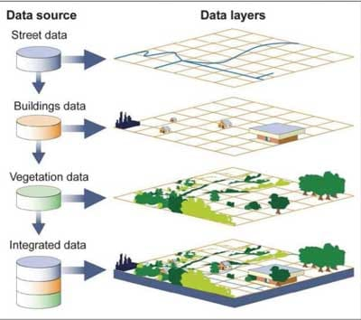
Achievers NR
TECHNICAL APPROACH
Technology and methodologies used
Methodology
Technologies used
\nits hacks 7.0
Python version 3.12.6 and java script
GPU Card
webGIS as database
Service for browsing images or maps
Efficiency of semantic segmentation for geospatial data
Joining small scale sharp images to large scale sharp images
Identification of elements
Comparing colour of pixels with the available emission spectra of elements
Defining distance between two images
Using numpy library to calculate distance between two dots(used for outlining)
Telling height and depth of landforms by overcoming shadow effects
By overcoming shadow effect and then comparing pixels of different locations
Using rgb2grey function of scikit module of python
3
@
nits hacks submission- template

Slide 4

Achievers NR
FEASIBILITY AND VIABILITY
\nits hacks 7.0
Feasibility of idea :
Completely depending upon the quality of map or image captured through drone/satellite.
Potential Challenges:
Elements which do not show any color or the water which is transparent , we may not find the element composition of these.
Geospatial images which are captured from sky or space then for the objects like trees , we cannot find the height as the trunk of tree would not be visible from that view.
4
@
nits hacks submission- template

Slide 5

Achievers NR
IMPACT AND BENEFITS
\nits hacks 7.0
Impacts:
The space missions for the remote sensing and analyzing the composition of elements will become cost effective.
Benefits:
Medical --→May be used for identifying concentration of different elements in blood.
Landforms --→Identification of elements of landforms of earth and different planets.
During space missions, it will be more easy to identify where to land the satellites or rovers.
5
@
nits hacks submission- template

Slide 6
Achievers NR
RESEARCH AND REFERENCES
\nits hacks 7.0
https://www.geeksforgeeks.org
https://stackoverflow.com
https://nptel.ac.in
https://www.Wikipedia.org
https://coursera.org
6
@
nits hacks submission- template

